Slide 1
COLA: Contextualized Commonsense Causal Reasoning from the Causal Inference Perspective
Zhaowei Wang, Do V. Quyet, Hongming Zhang, Jiayao Zhang, Weiqi Wang, Tianqing Fang, Yangqiu Song, Ginny Y. Wong & Simon See

Slide 2
1. Introduction
Commonsense Causal Reasoning:
Given a premise and two alternatives, the task is to select the alternative that more plausibly has a causal relation with the premise.
COPA^{[1]}
Premise: The man broke his toe. What was the CAUSE of this?
Alternative 1: He got a hole in his sock.
Alternative 2: He dropped a hammer on his foot.
Roemmele, Melissa, Cosmin Adrian Bejan, and Andrew S. Gordon. "Choice of Plausible Alternatives: An Evaluation of Commonsense Causal Reasoning." AAAI spring symposium: logical formalizations of commonsense reasoning. 2011.

Slide 3
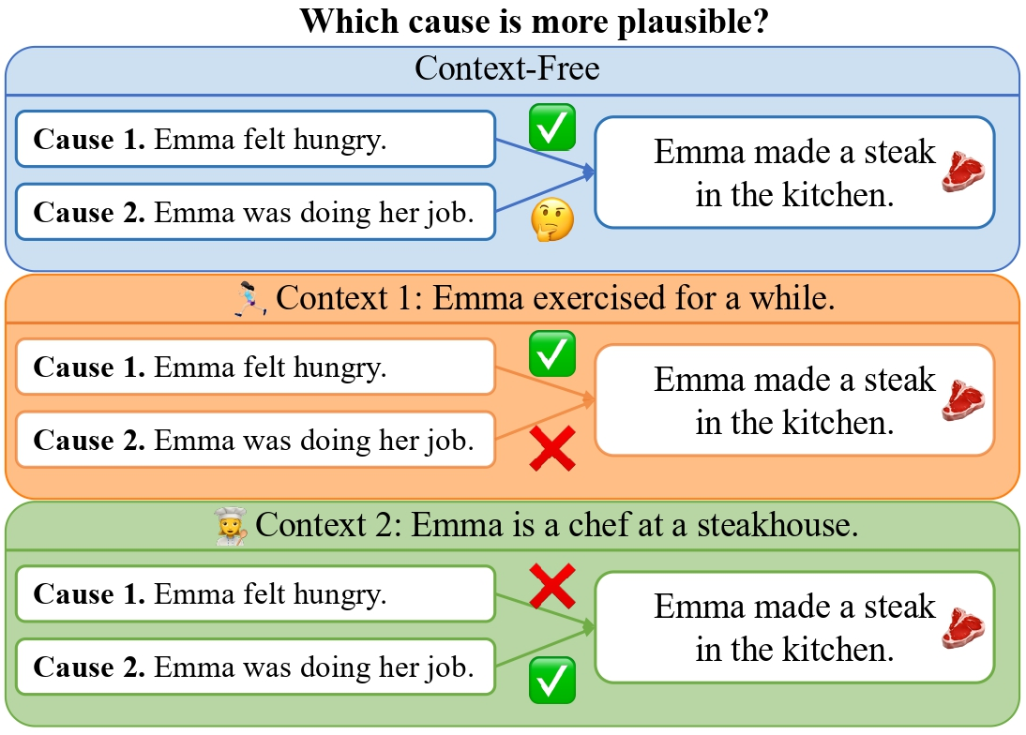
2. Motivation
Context?
1. The same event may have different causes in different contexts.
2. Current CCR work do not consider this.

Slide 4
3. Task Reformulation
Contextualized CCR
In a chain of events E₁, E₂, E₃, …, E_{n}: detect commonsense causal relation between two events.
(we sampled data from RocStories^{[2]})
Nasrin Mostafazadeh, Nathanael Chambers, Xiaodong He, Devi Parikh, Dhruv Batra, Lucy Vanderwende, Pushmeet Kohli, and James Allen. 2016. A Corpus and Cloze Evaluation for Deeper Understanding of Commonsense Stories. In Proceedings of NAACL, 2016.

Slide 5
4. Framework: Potential Outcome Framework
Covariates
(1) Multistamp Covariate Sampling
Event Timeline
(2) Intervention Generation
Interventions
Emma got up early.
$E_{1}$:
Bob felt sad.
…
…
Emma washed her face
Emma washed her face.
$E_{i−1}$:
Emma exercised for a while
Emma rode her bike.
Emma felt sad.
$E_{i}$:
Emma felt hungry
(3) Matched
Interventions
Emma brushed her teeth.
Emma felt hungry
…
$E_{n}$:
Emma made a steak in the kitchen
(4) Average Treatment Effect
1. multi-timestamp covariate sampling
2. intervention generation
3. selecting a set of matched interventions
4. computing average treatment effect

Slide 6
4. Framework: Average Treatment Effect
We model the causal relation as Average Treatment Effect (ATE)
We also use to indicate that E_{i} occurs before E_{j} for simplicity

Slide 7
4. Framework: Intervention
Event Timeline
(2) Intervention Generation
Interventions
$E_{1}$:
Bob felt sad
…
…
Emma washed her face
$E_{i−1}$:
Emma exercised for a while
Emma felt sad
$E_{i}$:
Emma felt hungry
Emma felt hungry
…
$E_{n}$:
Emma made a steak in the kitchen
Intervene the original event to get
Intervention v.s. negation?
Interpret intervention (manipulation) of semantic meanings in a broader sense:
If “Emma felt hungry” doesn’t happen, other events may happen!

Slide 8
4. Framework: Intervention
Event Timeline
Intervention Generation
Interventions
$E_{1}$:
Bob felt sad
…
…
Emma washed her face
$E_{i−1}$:
Emma exercised for a while
Emma felt sad
$E_{i}$:
Emma felt hungry
Emma felt hungry
…
$E_{n}$:
Emma made a steak in the kitchen
How to generate interventions?
Step 1: use SRL to detect verbs and arguments in the original event
Step 2: use PolyJuice^{[3]} to generate interventions in the cloze-the-blank style
Wu, Tongshuang, et al. "Polyjuice: Generating Counterfactuals for Explaining, Evaluating, and Improving Models."
Proceedings of ACL. 2021.

Slide 9
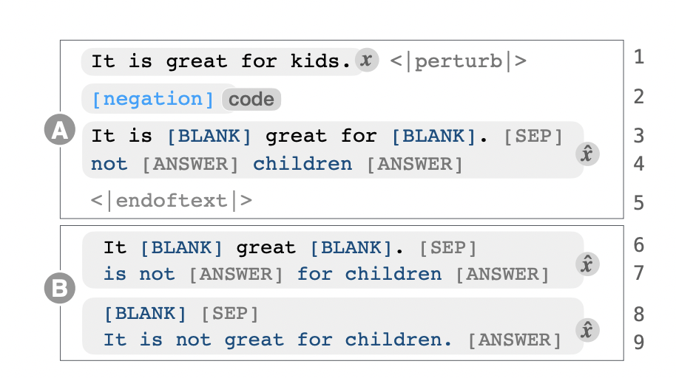
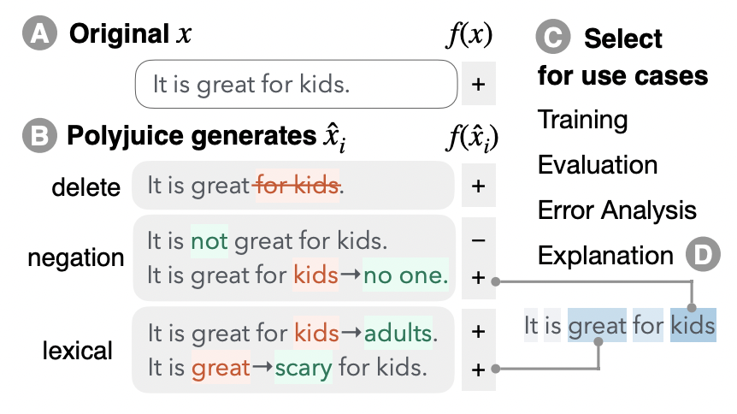
4. Framework: Intervention
Figures are from the PolyJuice paper
How to generate interventions?
Step 1: use SRL to detect verbs and arguments in the original event
Step 2: use PolyJuice^{[3]} to generate interventions in the cloze-the-blank style
Wu, Tongshuang, et al. "Polyjuice: Generating Counterfactuals for Explaining, Evaluating, and Improving Models."
Proceedings of ACL. 2021.

Slide 10
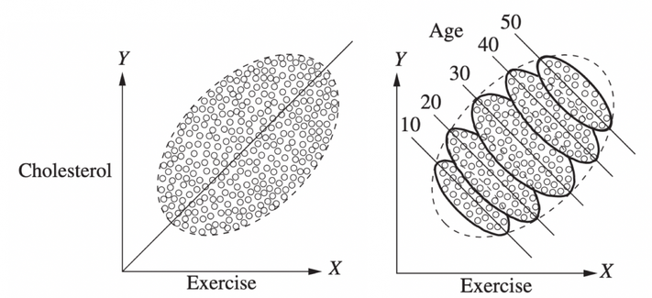
4. Framework: Covariate
Figures are from the book:
Causal Inference in Statistics: A Primer
Confounding effect and Simpson’s Paradox?
age
exercise
cholest.

Slide 11
4. Framework: Balancing Covariate
Covariates
Multistamp Covariate Sampling
Event Timeline
Emma got up early.
$E_{1}$:
…
…
Emma washed her face.
$E_{i−1}$:
Emma exercised for a while
Emma rode her bike.
$E_{i}$:
Emma felt hungry
Emma brushed her teeth.
…
$E_{n}$:
Emma made a steak in the kitchen
We need to sample covariates:
Covariates are events that happen before both events.
Use a decoder-only model to sample events (GPT-J)
Prompt template: “E_{i.} Before that, ”
Multi-timestamps: events that before E₁, E₂, E₃, …, E_{i} are all valid covariates.

Slide 12
4. Framework: Intervention Matching
Covariates
(1) Multistamp Covariate Sampling
Event Timeline
(2) Intervention Generation
Interventions
Emma got up early.
$E_{1}$:
…
…
Bob felt sad.
Emma washed her face.
$E_{i−1}$:
Emma exercised for a while
Emma washed her face
Emma rode her bike.
$E_{i}$:
Emma felt hungry
Emma felt sad.
Emma brushed her teeth.
…
Emma felt hungry
$E_{n}$:
Emma made a steak in the kitchen
(3) Matched
Interventions
Matching Temporal Propensities:
With covariates, then compute propensity scores to balance covariates
Find interventions that have similar propensity scores
Temporal Propensity:
x means covariates

Slide 13
4. Framework: Intervention Matching
Covariates
(1) Multistamp Covariate Sampling
Event Timeline
(2) Intervention Generation
Interventions
Emma got up early.
$E_{1}$:
…
…
Bob felt sad.
Emma washed her face.
$E_{i−1}$:
Emma exercised for a while
Emma washed her face
Emma rode her bike.
$E_{i}$:
Emma felt hungry
Emma felt sad.
Emma brushed her teeth.
…
Emma felt hungry
$E_{n}$:
Emma made a steak in the kitchen
(3) Matched
Interventions
How to estimate probabilities of temporal relations:
Fine-tune an MLM to estimate probabilities of temporal relations
Input: E_{i} [MASK] E_{n}
Output: [MASK] -> before/after/[none]

Slide 14
4. Framework: ATE
Covariates
(1) Multistamp Covariate Sampling
Event Timeline
(2) Intervention Generation
Interventions
Emma got up early.
$E_{1}$:
Bob felt sad.
…
…
Emma washed her face
Emma washed her face.
$E_{i−1}$:
Emma exercised for a while
Emma rode her bike.
Emma felt sad.
$E_{i}$:
Emma felt hungry
(3) Matched
Interventions
Emma brushed her teeth.
Emma felt hungry
…
$E_{n}$:
Emma made a steak in the kitchen
(4) Average Treatment Effect
Compute Average Treatment Effect (ATE):
With a matched set of interventions A’, we can rewrite the ATE formula as follow:

Slide 15
5. Experiments
Dataset: Choice of Plausible Event in Sequence (COPES)
Size: 1360 event pairs
Crowd sourced on Amazon Mechanical Turk
Event chains are sampled from RocStories
Baselines:
CLM Perplexity: use perplexity scores produced by a CLM (like GPT2) to predict commonsense causal relations.
Cloze Prompt Score: Mask every token and compute the likelihood of every token and the take average; a pseudo-likelihood method.
ROCK: a zero-shot framework based on causal inference
Metrics:
Accuracy, F1, Macro-F1

Slide 16
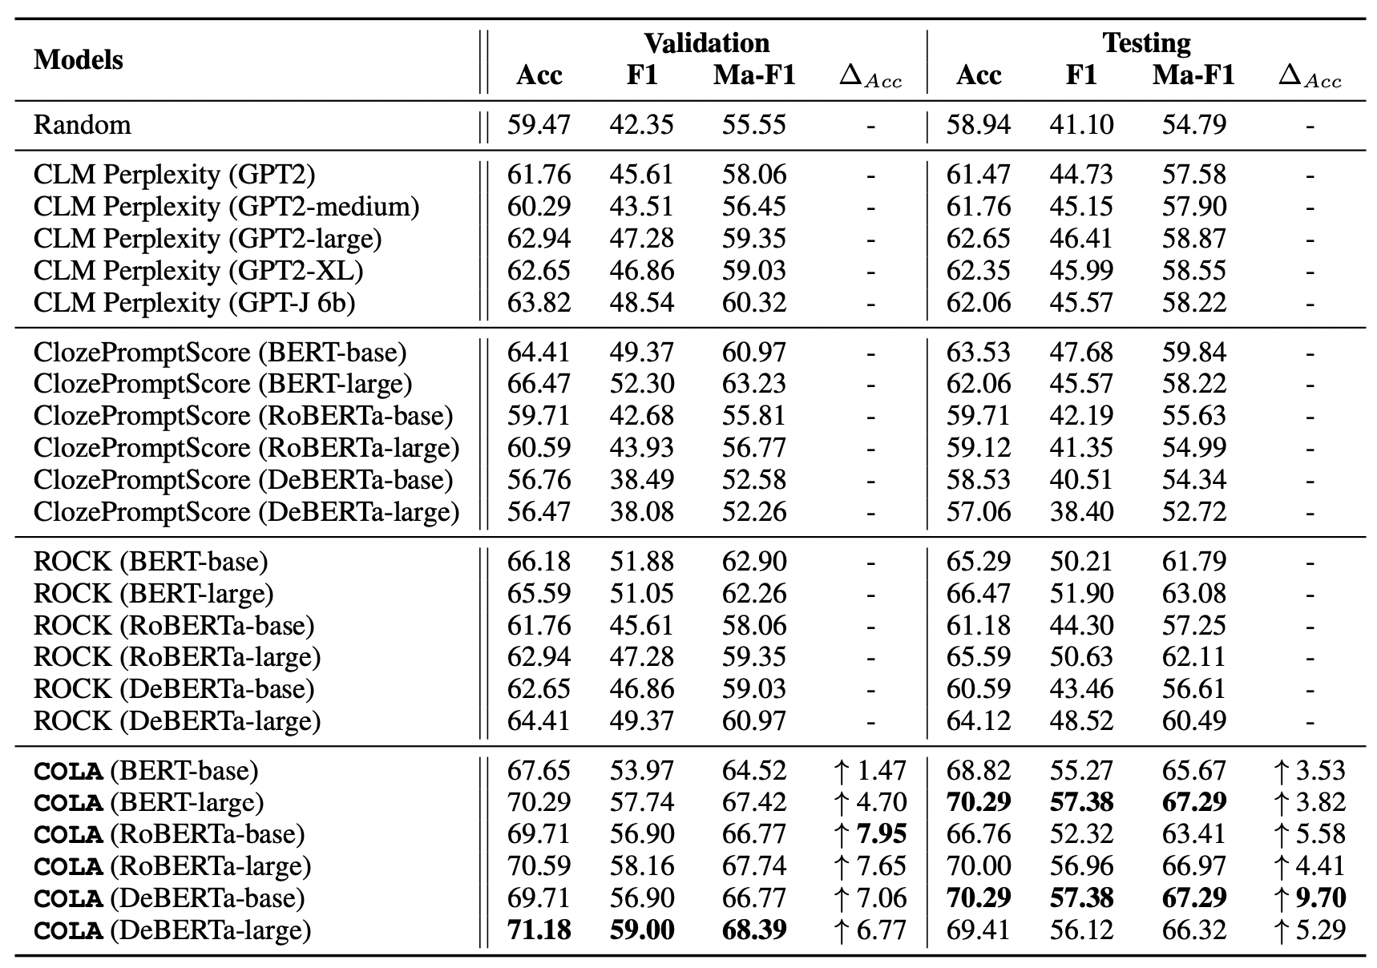
5. Experiments: Main Results
We test each baseline based on different LMs
In COLA: we also fine-tune different LMs to estimate temporal probabilities

Slide 17
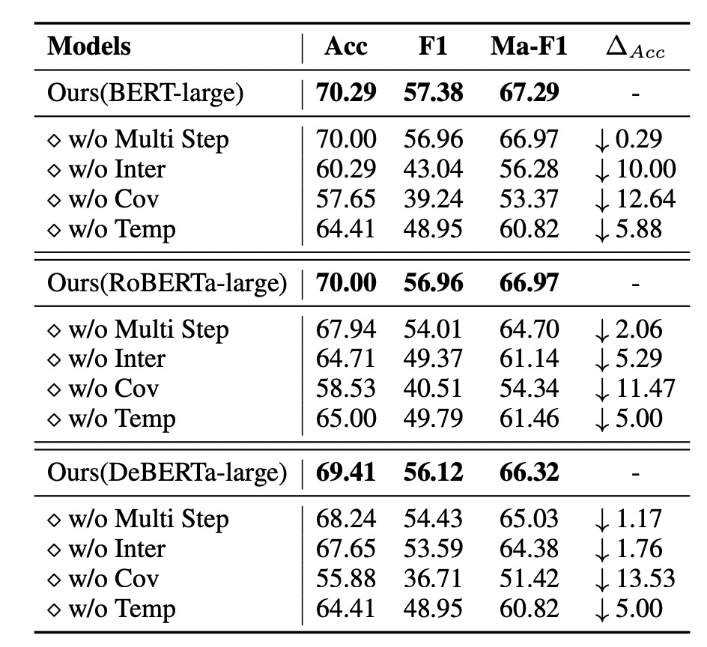
5. Experiments: Ablation
w/o Multi Step: only sample covariates based on E_{i}
w/o Inter: no intervention; directly use temporal scores
w/o Cov: use all interventions without balancing covariates
w/o Temp: directly use a MLM without fine-tuning.

Slide 18
5. Experiments: Hyperparameter Search
Baselines:
ROCK
Cloze Prompt Score (CPS)
Random Performance
Range from 0 to 0.5
Recommendation [0, 0.1]

Slide 19
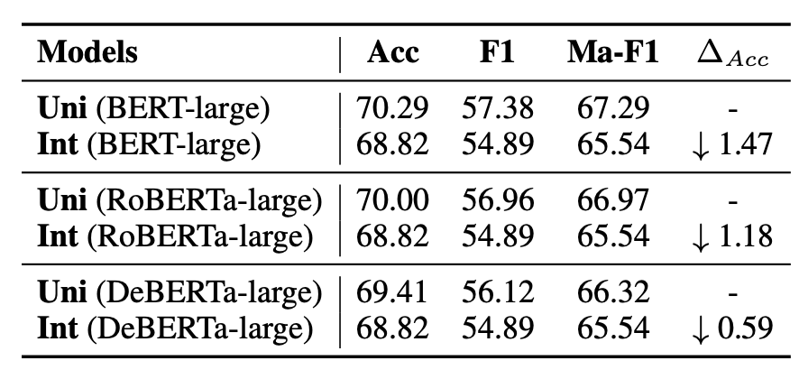
5. Experiments: Discussion
Comparison with ChatGPT?
Sample 120 examples and manually read the results of ChatGPT.
Our framework works better with much less parameter.
How to sample covariates based on
multiple timestamps?
Union: Sample each covariate based on E₁, E₂, E₃, …, E_{j}, respectively
Intersection: Sample each covariate based on E_{i}, E_{i+1}, E_{i+2}, …, E_{n}, jointly

