Slide 1
SubeventWriter: Iterative Sub-event Sequence Generation with Coherence Controller
Zhaowei Wang, Hongming Zhang, Tianqing Fang, Yangqiu Song, Ginny Y. Wong & Simon See

Slide 2
Understanding Process
Process^{[1]}:
Definition: a complex event constituted by a sequence of sub-events.
Also called script^{[2]} and activity^{[3]}.
How to make a chocolate cake: Step 1: Mix the dry ingredients. Step 2: Pour batter into cake pans. Step 3: Add the coffee and milk. Step 4: Bake the cake.
Actions: mix, add, pour, bake.
Abjects: dry ingredients, batter, cake pans, coffee, milk, cake
Coherence!

Slide 3
Related Work
narrative cloze tasks^{[4]}:
given previous events, select what will happen next from a set of candidates.
emphasize on semantic similarity and relatedness between target events and context
process induction^{[5]}:
1. generate a sequence of structured sub-events a given process
2. structured events -> missing information & not coherent
3. focusing on conceptualization and instantiation, not coherence.
How to make a chocolate cake?
(Mix, ingredients.)
(Add, coffee and milk)
…

Slide 4
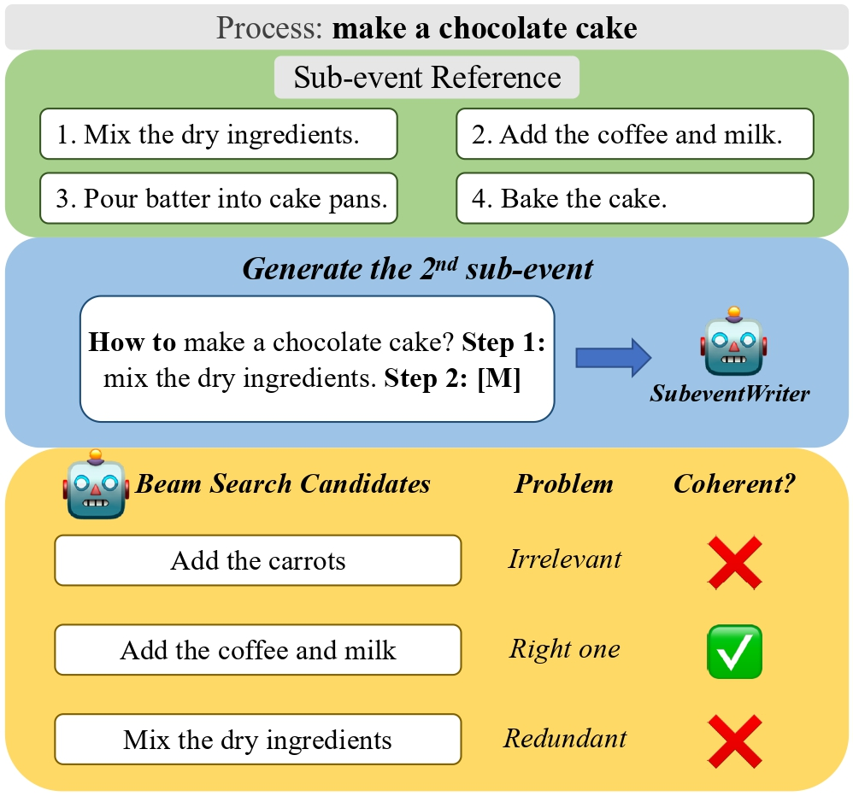
Emphasizing coherence
Given a process, can language models generate right steps in textual form?
Our motivation is about coherence among events when generating them.

Slide 5
Model structure
Iterative Event-level Decoding: a Seq2Seq Language Model generate steps one by one.
Coherence Controller: a masked language model generates coherence scores.

Slide 6
Iterative Event-level Decoding
We fine-tuned the Seq2Seq LM to generate one step a time
e.g., BART and T5
Training:
Process -> Step1
Process + Step1 -> Step2
Process + Step1 + Step2 -> Step3
Process + Step1 + Step2 + Step3 -> NULL

Slide 7
Coherence Controller
Local Coherence: the logical relation between two adjacent sub-events^{[6]}
Global Coherence: the theme among all sub-events^{[6]}
Binary classification:
coherent sub-event sequences v.s. incoherent sub-event sequences
Ground Truth (positive): Process, Step1, Step2, Step3.
Local coherence (negative): Process, Step1, Step2, Step1, Step3.
Global coherence (negative): Process, Step1, Step2, StepX (from another process), Step3.
Loss: cross-entropy

Slide 8
Baseline
All-at-once Seq2Seq:
Seq2Seq language models are fine-tuned to predict all sub-events at once
Top-one Similar Sequence:
This baseline finds the most similar process in the training data, for each unseen process in the validation or testing set,
Zero-shot Large LM:
the zore-shot performance of large language models, such as T5-11b and GPT-J (6b)

Slide 9
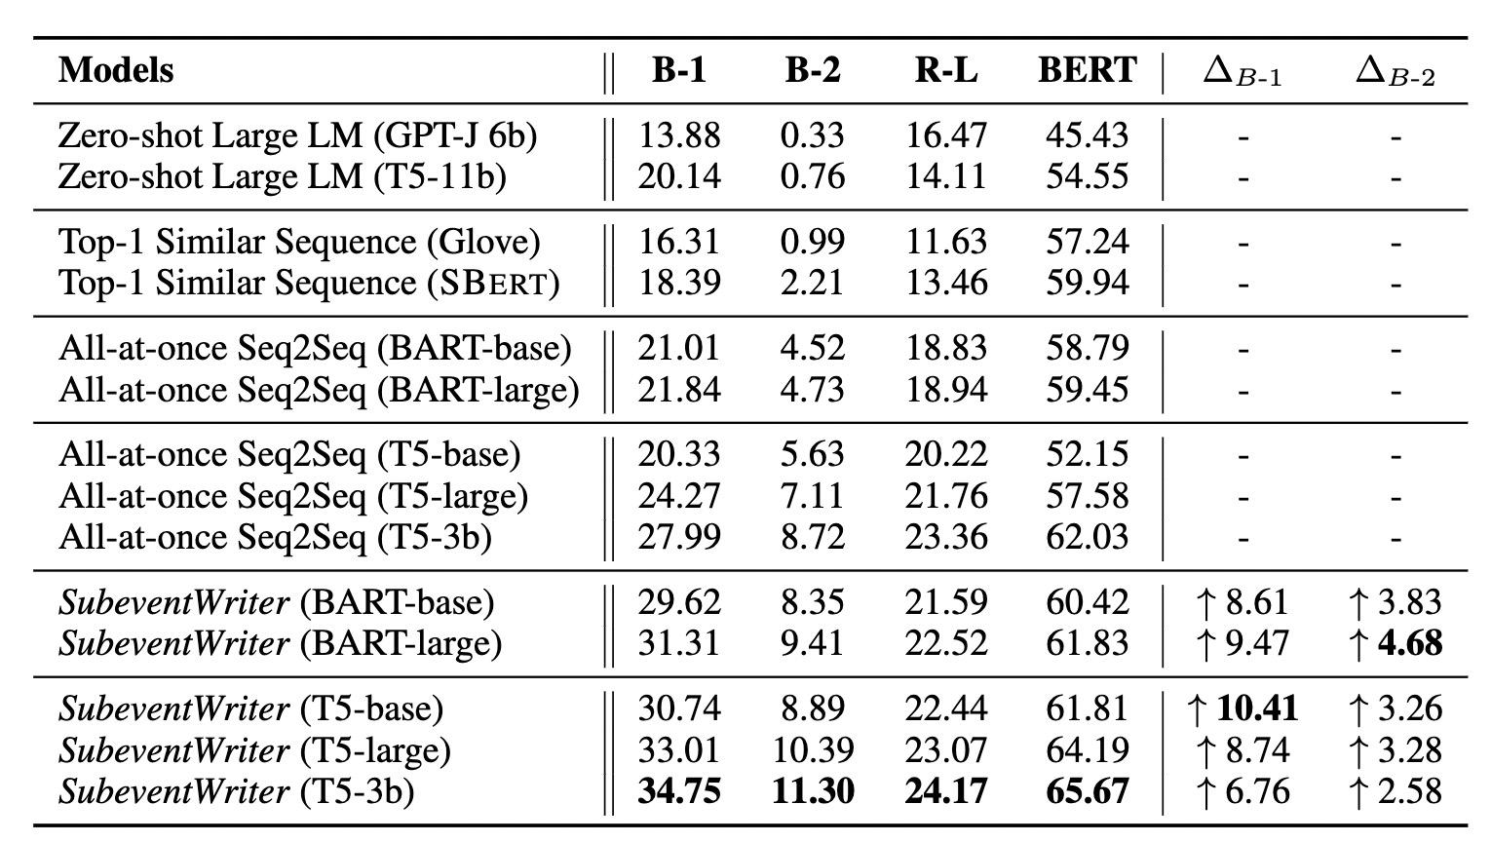
Results
~83k processes
from WikiHow
Seq2Seq Models:
BART-base/large
T5-base/large/3b

Slide 10
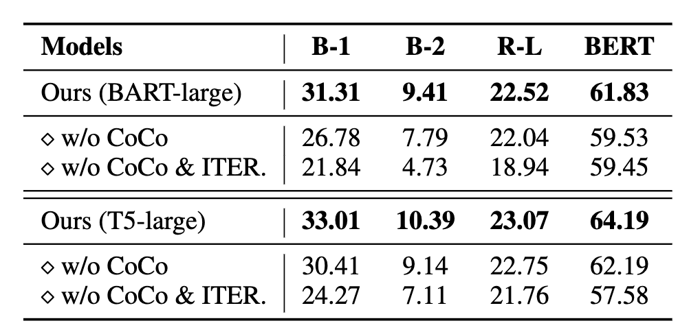
Ablation Study
CoCo cannot stay alone (i.e., no "w/o ITER")
CoCo for "Coherence Controller"
ITER for "Iterative Event-level Decoding"
Other models in appendix D.1

Slide 11
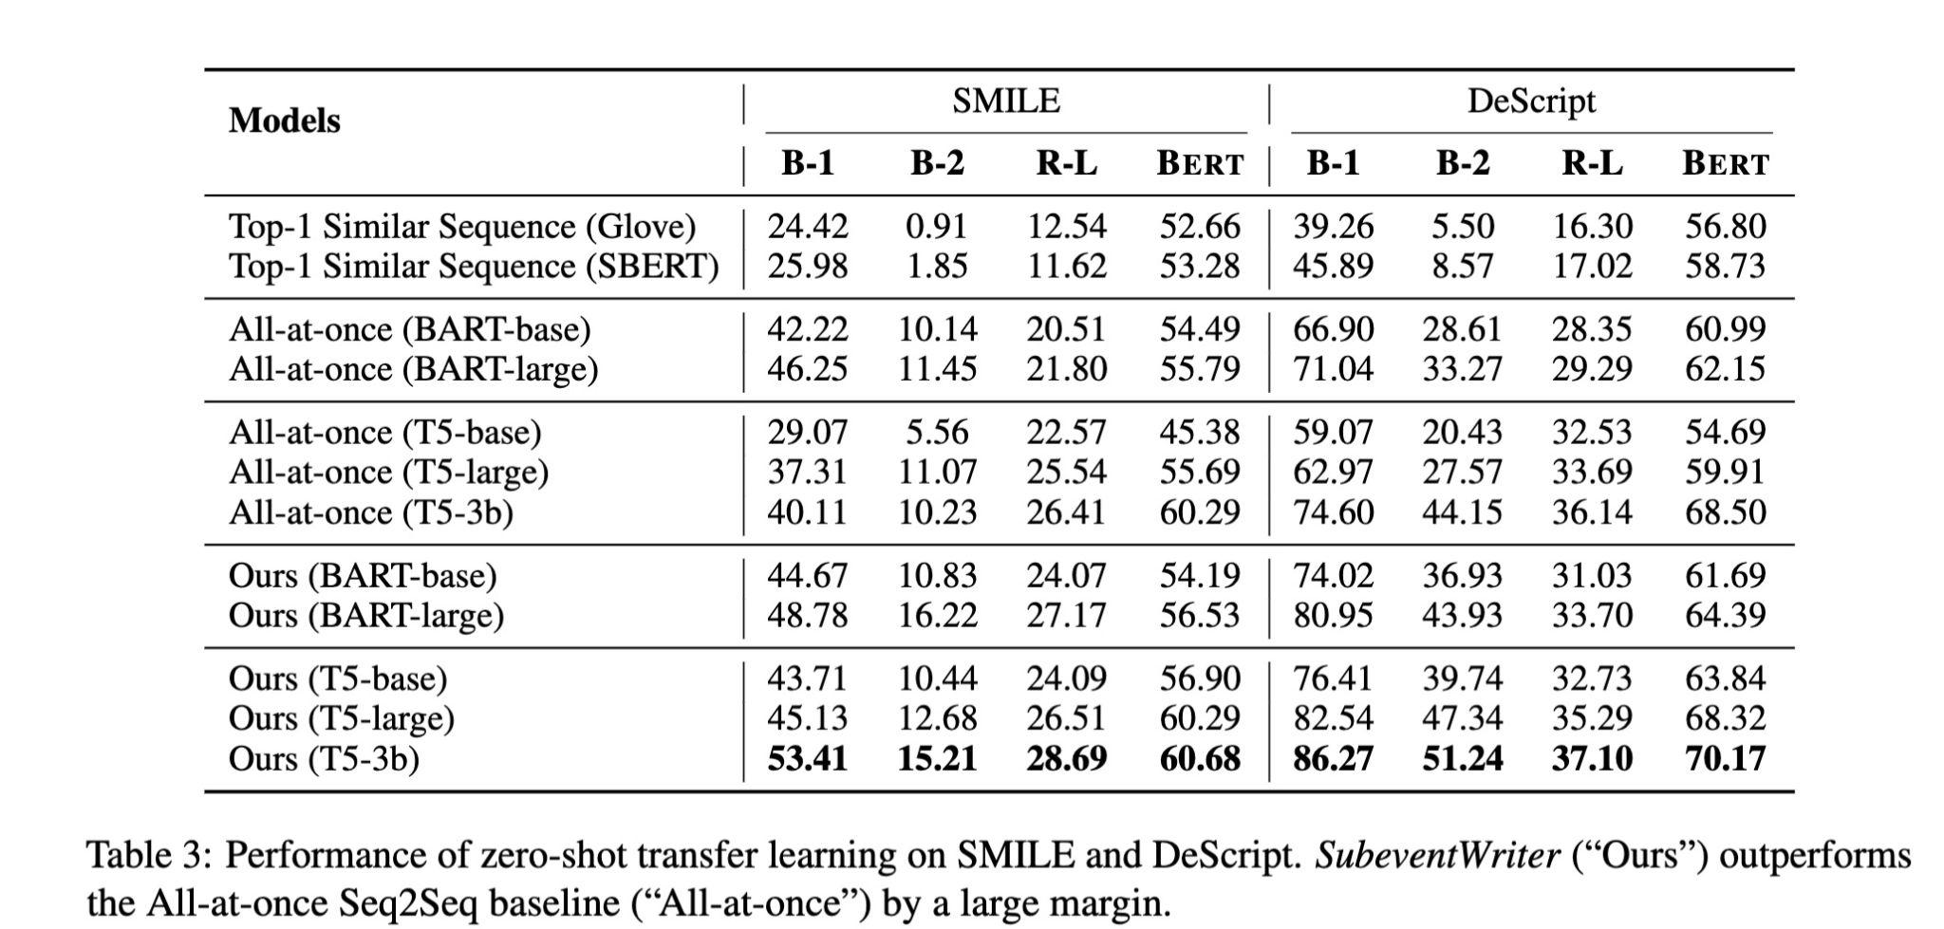
Zero-shot transfer learning
Datasets: SMILE^{[7]} and DeScript^{[8]}

Slide 12
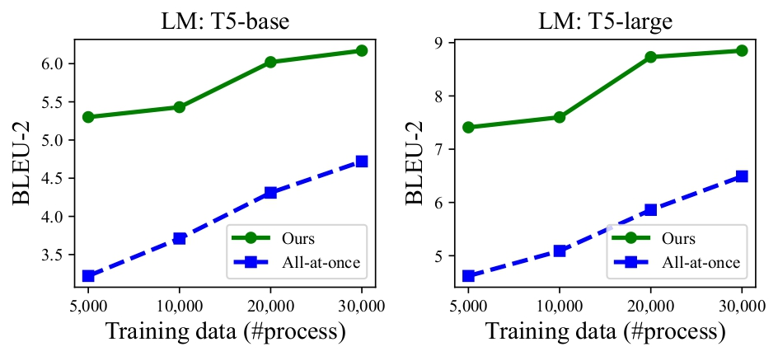
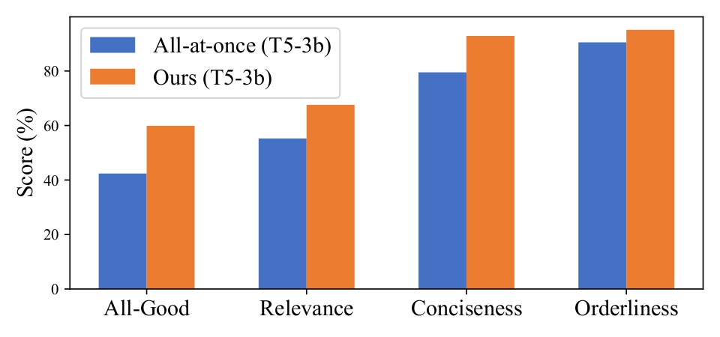
Few-shot experiments & Human evaluation
Few-show
Other models in Appendix D.2
Human Evaluation

Slide 13
[1] Craig, Edward, ed. Routledge encyclopedia of philosophy: Index. Vol. 8. Taylor & Francis, 1998.
[2] Schank, Roger C., and Robert P. Abelson. "Scripts, plans, goals, and understanding: an inquiry into human knowledge structures." (1977): 256-pages.
[3] Mourelatos, Alexander P. D. “Events, Processes, and States.” Linguistics and Philosophy 2, no. 3 (1978): 415–34. http://www.jstor.org/stable/25000995.
[4] Chambers, Nathanael, and Dan Jurafsky. "Unsupervised learning of narrative event chains." In Proceedings of ACL-08: HLT, pp. 789-797. 2008.
[5] Zhang, Hongming, Muhao Chen, Haoyu Wang, Yangqiu Song, and Dan Roth. "Analogous Process Structure Induction for Sub-event Sequence Prediction." In Proceedings of the 2020 Conference on Empirical Methods in Natural Language Processing (EMNLP), pp. 1541-1550. 2020.
[6] Van Dijk, Teun A. "The semantics and pragmatics of functional coherence in discourse." Speech act theory: Ten years later (1980): 49-65.
[7] Regneri, Michaela, Alexander Koller, and Manfred Pinkal. "Learning script knowledge with web experiments." In Proceedings of the 48th Annual Meeting of the Association for Computational Linguistics, pp. 979-988. 2010.
[8] Wanzare, Lilian DA, Alessandra Zarcone, Stefan Thater, and Manfred Pinkal. "A crowdsourced database of event sequence descriptions for the acquisition of high-quality script knowledge." In Proceedings of the Tenth International Conference on Language Resources and Evaluation (LREC'16), pp. 3494-3501. 2016.

