Slide 1
MMLongBench: Benchmarking Long-Context Vision-Language Models Effectively and Thoroughly
Zhaowei Wang, Wenhao Yu, Xiyu Ren, Jipeng Zhang, Yu Zhao,
Rohit Saxena, Liang Cheng, Ginny Wong, Simon See,
Pasquale Minervini, Yangqiu Song, and Mark Steedman

Slide 2
Introduction
Context windows of Large Vision-Language Models extend rapidly
: From 8K (InternVL2) to 32K (InternVL3)
: From 2K (Qwen-VL) to 32K (Qwen2.5-VL)
GPT4o:128K
GPT4.1: 1M
Sonnet 3.7: 200K
Sonnet 4: 200K
Gemini 2: 1M
Gemini 2.5: 1M
Long-Context Vision-Language Models (LCVLMs)!

Slide 3
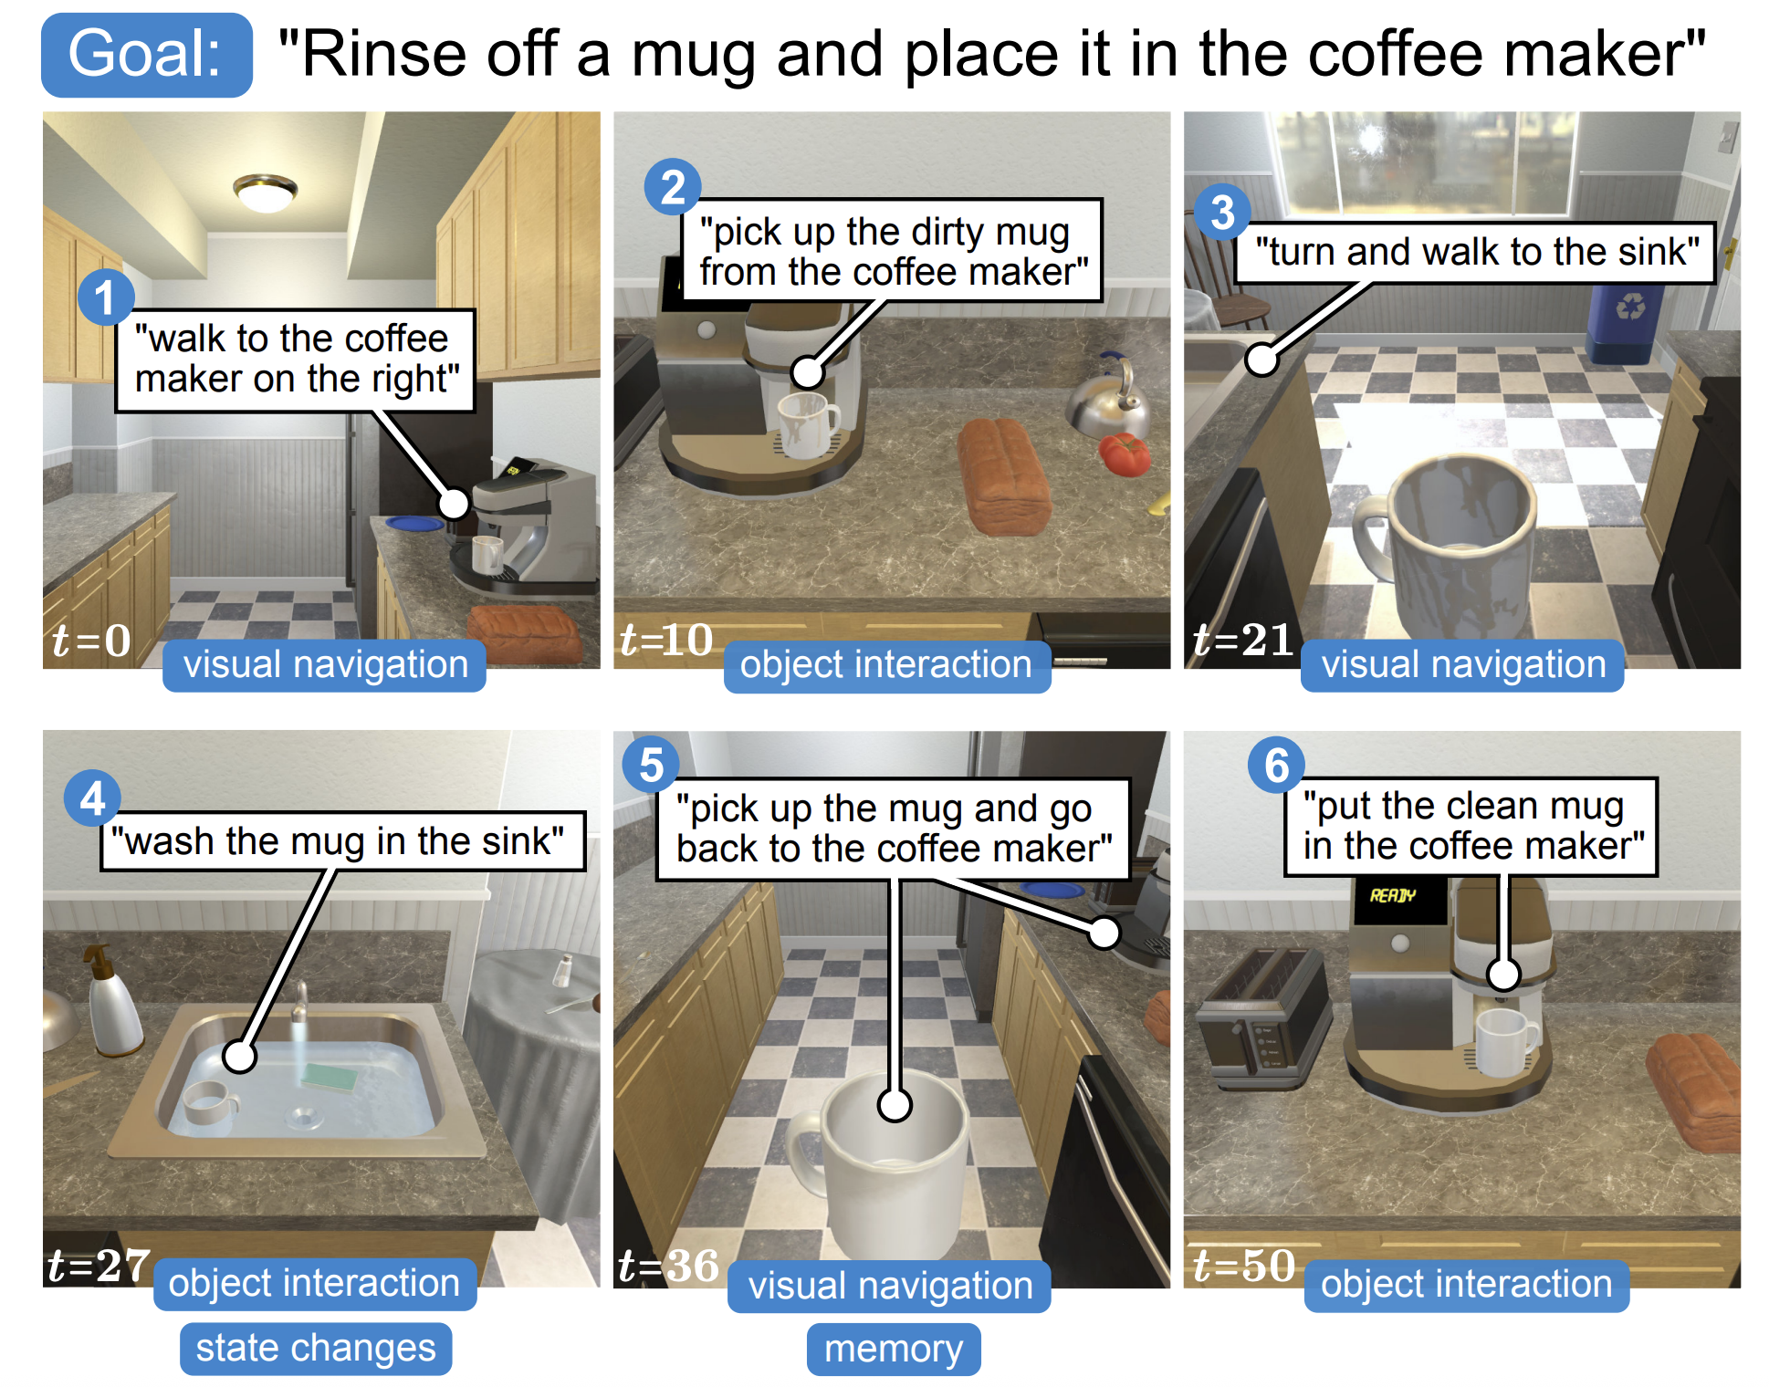
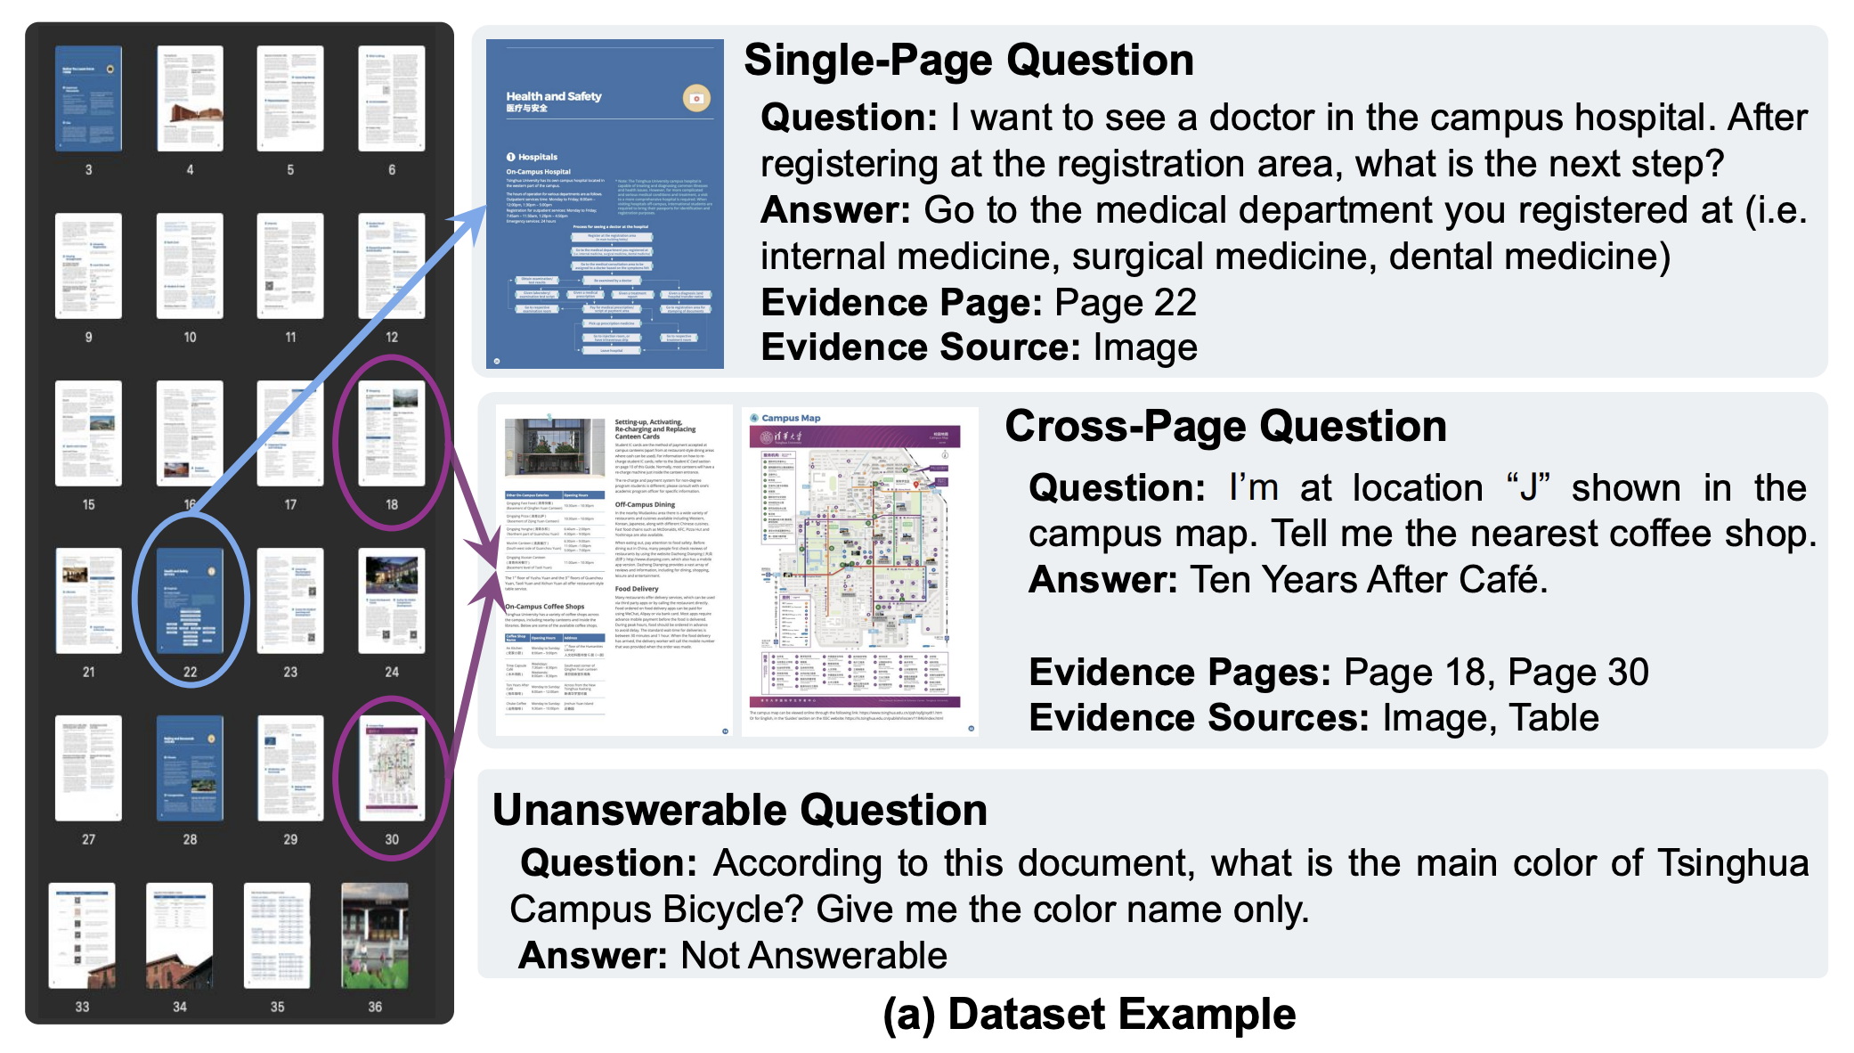
Introduction
Also, multiple web pages,
various softwares, etc.
Why Long-Context?
A wide array of applications:
Long Agent History^{[1]}
Document-Level VQA^{[2]}
[1] Shridhar, Mohit, et al. "Alfred: A benchmark for interpreting grounded instructions for everyday tasks." CVPR. 2020.
[2] Ma, Yubo, et al. "MMLONGBENCH-DOC: Benchmarking Long-context Document Understanding with Visualizations." Neurips, 2024.

Slide 4
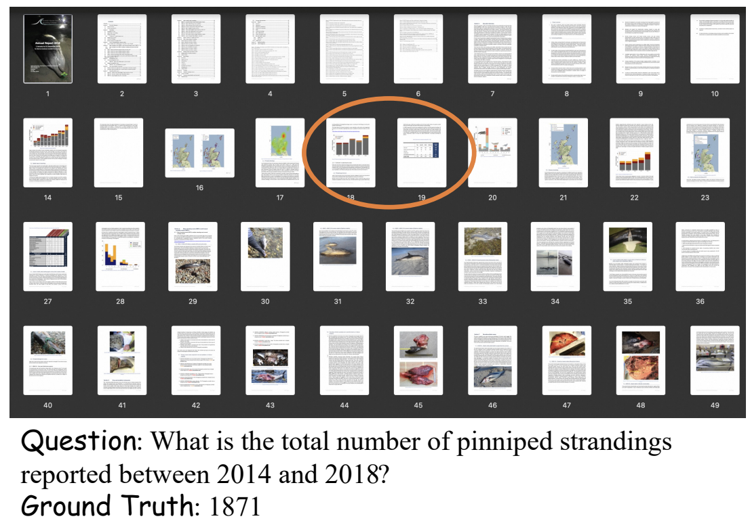
Problem Analysis
However, evaluation of long context lags behind:
Limited task coverage
Multimodal NIAH^{[3]}
Long-Document VQA
[3] Wang, Weiyun, et al. "Needle in a multimodal haystack." Neurips, 2024.

Slide 5
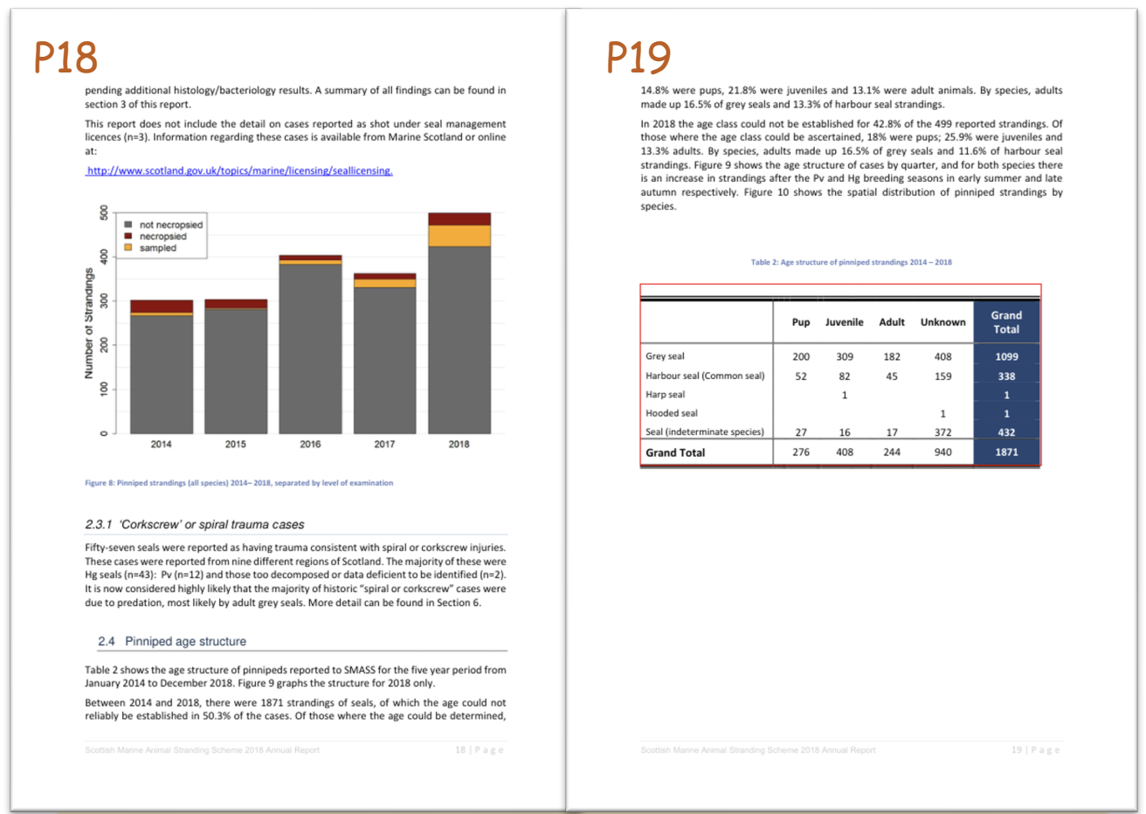
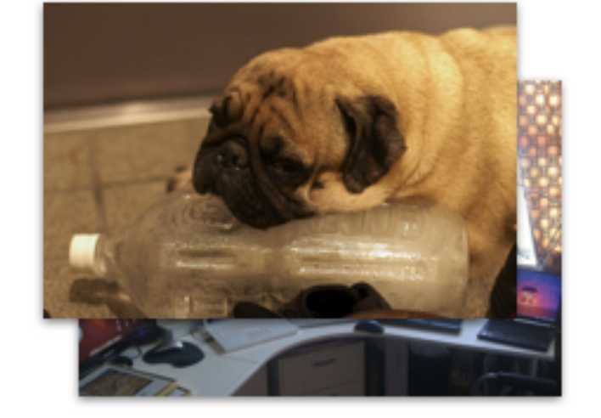
Problem Analysis
However, evaluation of long context lags behind:
Lack of image type diversity
Natural: everyday scenes, objects, or people
e.g., Visual Haystack^{[4]} uses COCO^{[5]} datasets
Synthetic: scanned documents, model generation
e.g., LongDocURL^{[6]} uses various PDFs
[4] Wu, Tsung-Han, et al. "Visual Haystacks: A Vision-Centric Needle-In-A-Haystack Benchmark." arXiv preprint arXiv:2407.13766 (2024).
[5] Lin, Tsung-Yi, et al. "Microsoft coco: Common objects in context." ECCV, 2014.
[6] Deng, Chao, et al. "LongDocURL: a Comprehensive Multimodal Long Document Benchmark Integrating Understanding, Reasoning, and Locating." arXiv preprint arXiv:2412.18424 (2024).

Slide 6
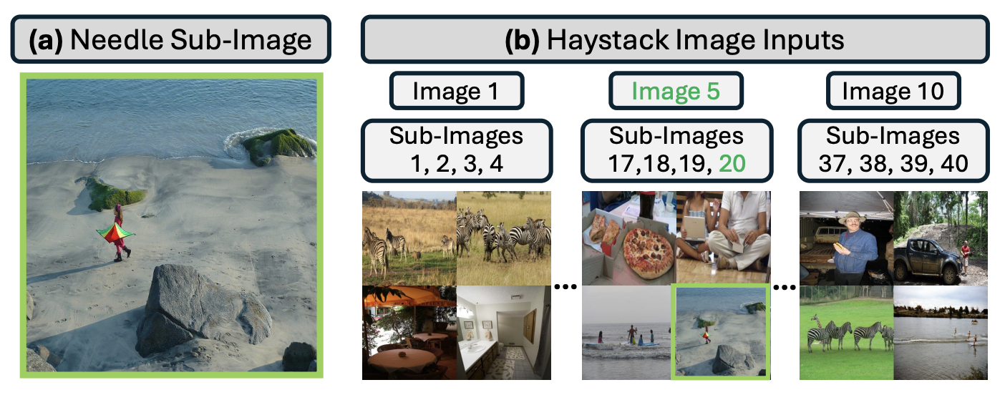
Problem Analysis
However, evaluation of long context lags behind:
Inconsistent context length control
Visual Haystack
Multimodal Needle in a Haystack^{[7]}
Use image number as the context length:
Different image sizes
Text token: prompt, question, etc
[7] Wang, Hengyi, et al. "Multimodal needle in a haystack: Benchmarking long-context capability of multimodal large language models." NAACL, 2024.

Slide 7
Problem Analysis
However, evaluation of long context lags behind:
Inconsistent context length control
MM-NIAH:
Use InternVL1.5
Count both text and image tokens
Image number or token number?

Slide 8
Problem Analysis
However, evaluation of long context lags behind:
Lack of standardized input lengths
MM-NIAH:
Long web pages with random length
How the performance changes?
Standard Lengths: 8K, 16K, …, 128K

Slide 9
MMLongBench Overview
Design principles and goals
Diverse task and image coverage
Cross-modal token counting
Multiple standardized input lengths

Slide 10
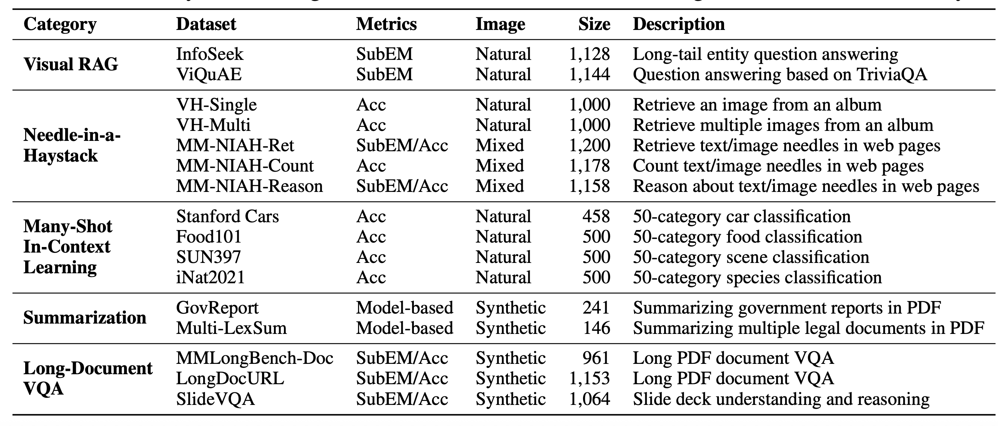
MMLongBench Overview
1. Diverse task (16 datasets, 5 categories, 13,331 examples)

Slide 11
MMLongBench Overview
2. Cross-modal token counting
Llama2 tokenizer
14x14 patches and 2x2 pixel unshuffle
3. Multiple Standardized Length
Each example with 8K, 16K, 32K, 64K, and 128K context lengths

Slide 12
Task Categories & Datasets
Visual RAG
Dataset: Infoseek, ViQuAE
Knowledge-based VQA
Gold Reference
Wikipedia, 100-word chunk
BM25 + Embedding model
Substring Exact Match

Slide 13
Task Categories & Datasets
Needle-in-a-Haystack (NIAH)
Dataset: Visual Haystack
Find objects
Haystack of natural images
Single or multiple needles
Yes or No, binary

Slide 14
Task Categories & Datasets
Needle-in-a-Haystack (NIAH)
Dataset: MM-NIAH
Retrieval, Count, and Reasoning
Text or image needle
Haystack of webpages
SubEM or Acc

Slide 15
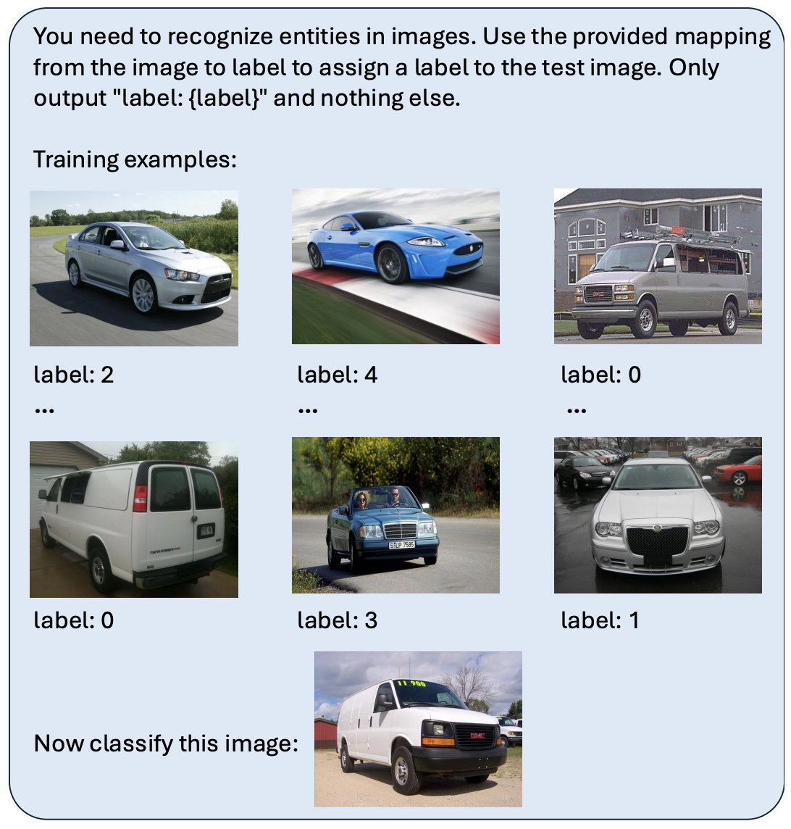
Task Categories & Datasets
Many-shot In-Context Learning (ICL)
Stanford Cars, Food101,
SUN397, iNat2021
On-the-fly image classification
Class ID, not original name
Control exemplar number

Slide 16
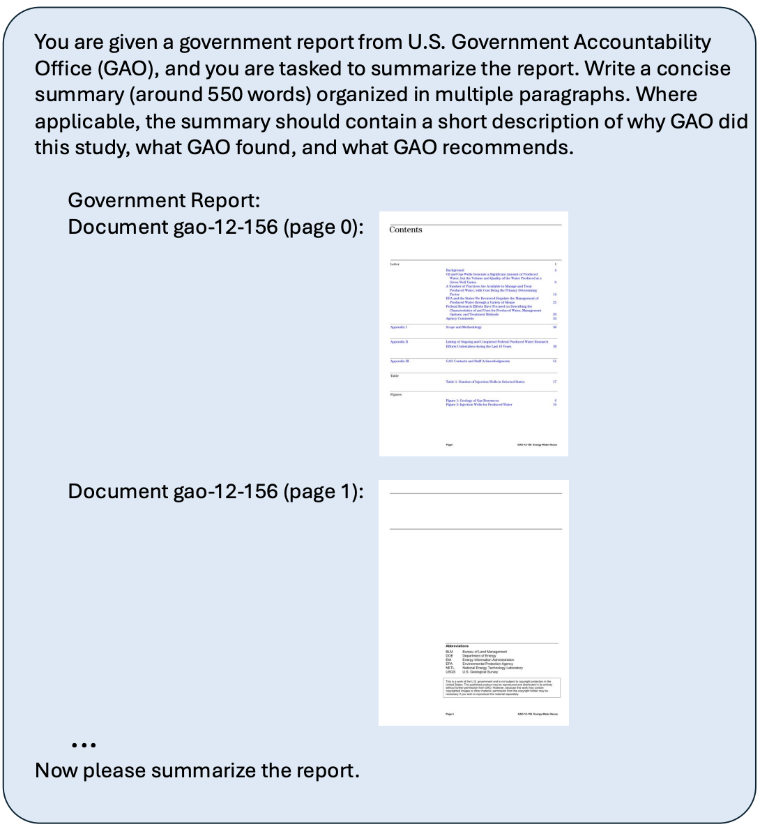
Task Categories & Datasets
Summarization (Summ)
Dataset: GovReport, Multi-LexSum
PDF-formatted documents
Not OCR-extracted texts
Using GPT-4o to evaluate
Truncate from the end

Slide 17
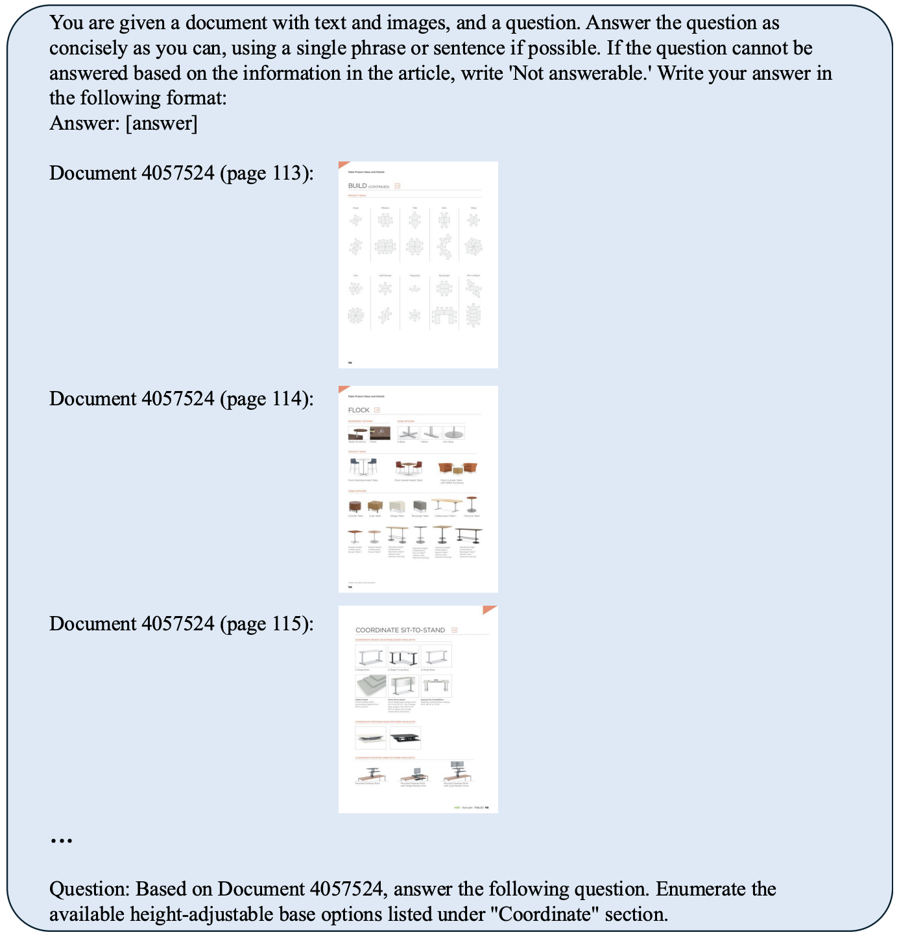
Task Categories & Datasets
Long-Document VQA (DocVQA)
Dataset: MMLongBench-Doc
LongDocURL, SlideVQA
PDF-formatted documents
Concatenate or truncate documents

Slide 18
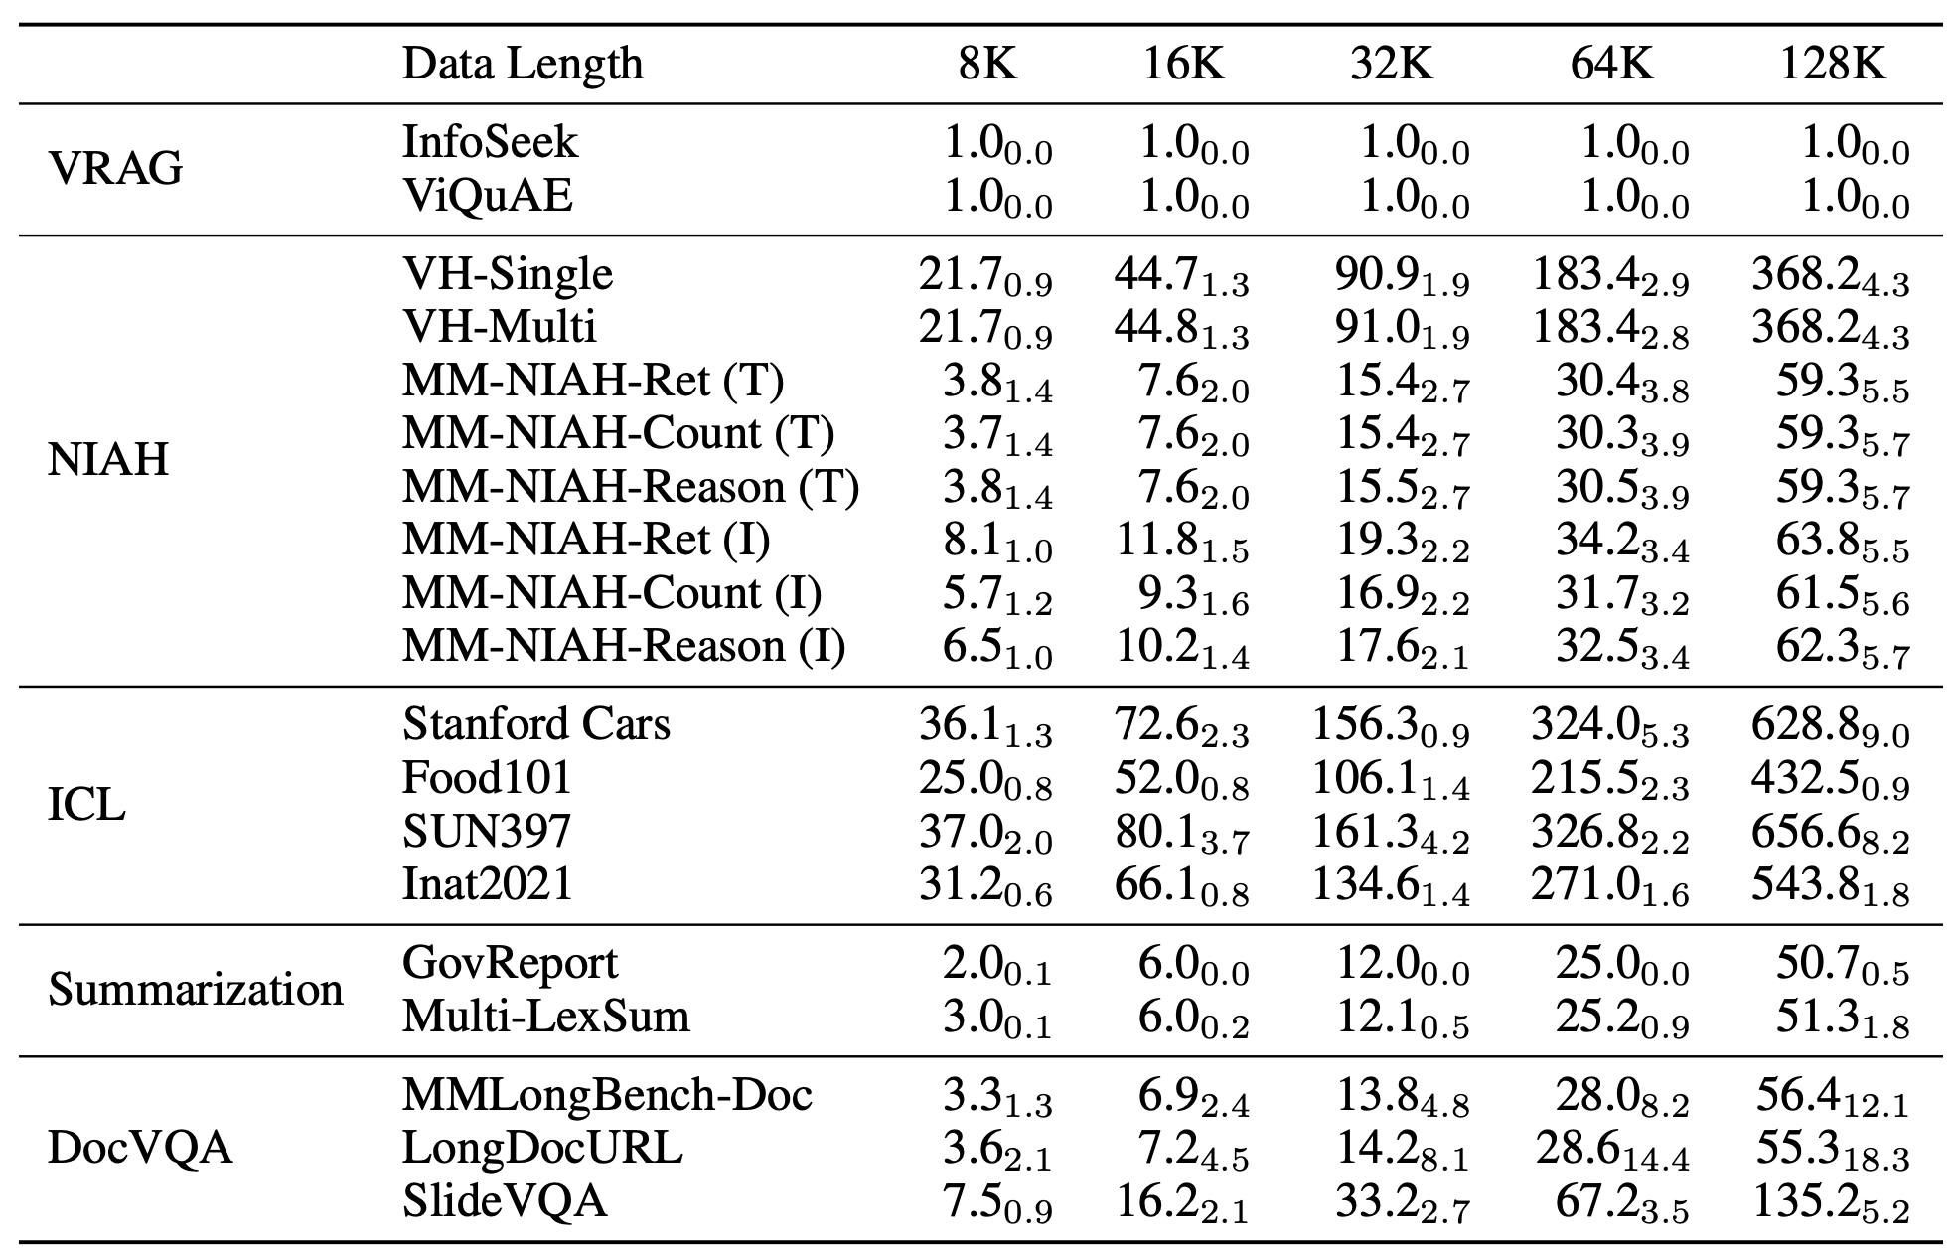
Image Number

Slide 19
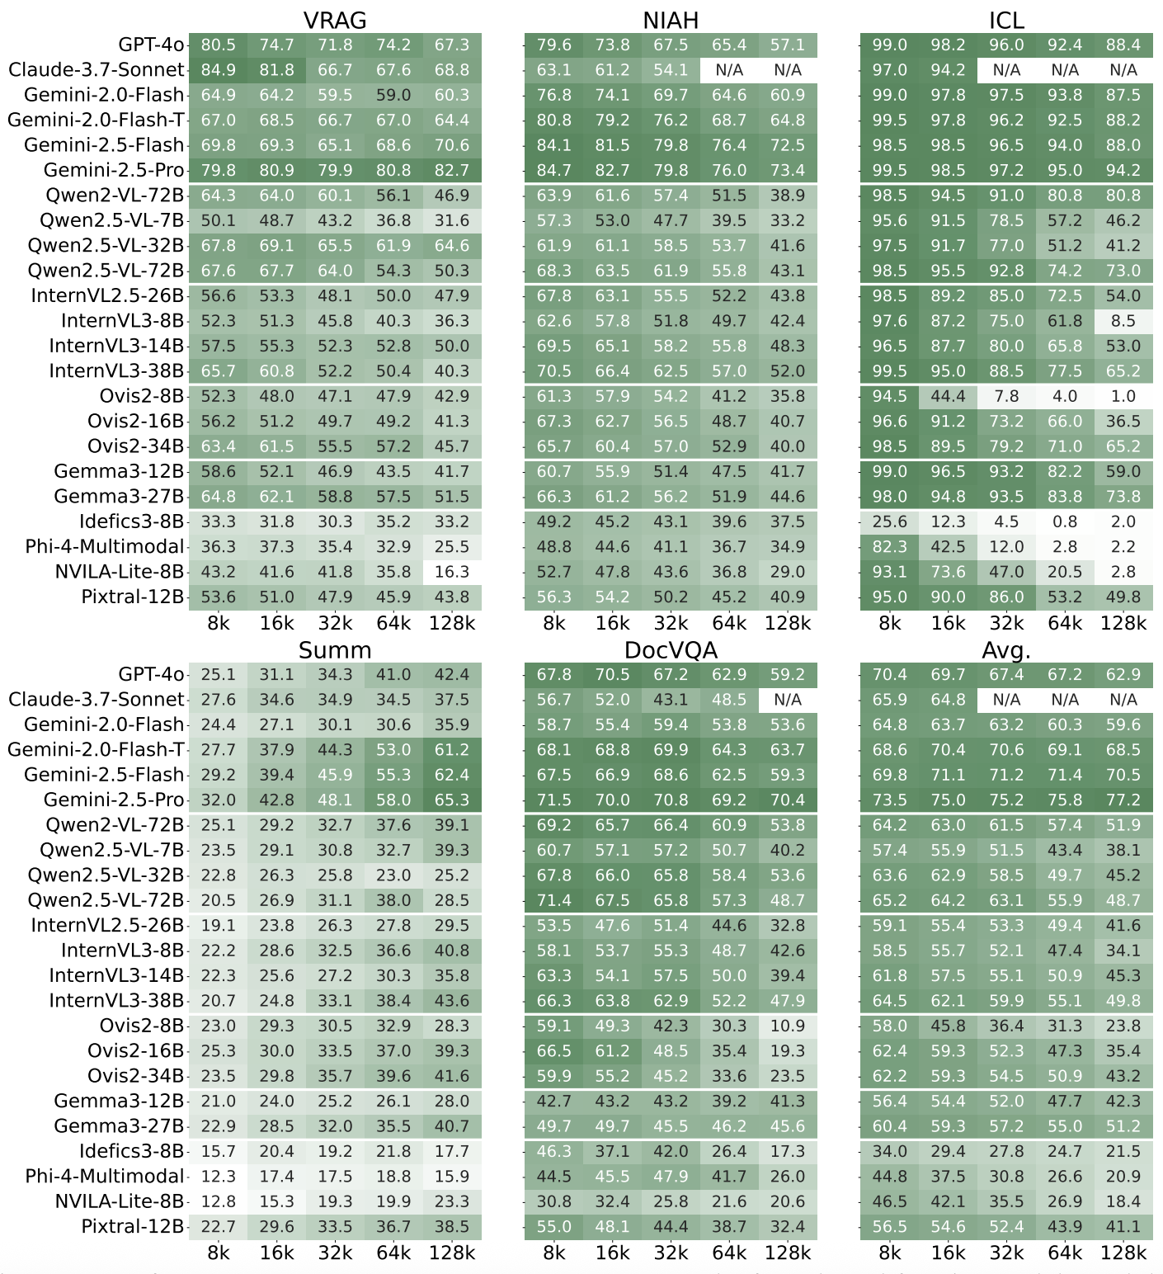
Experimental Results
1. All models struggle, but closed-source models perform better.
Gemini-2.5-Pro is the best.
2. Models can generalize to longer context lengths.
Qwen2-VL-32B
Ovis2-34B

Slide 20
Experimental Results
3. Reasoning can improve multimodal long-context ability.
Gemini-2.0-Flash-T
Gemini2.5-Flash&Pro
4. Different models exhibit different strengths.
Qwen2.5-VL-32B better on VRAG
InternVL3-38B better on NIAH
Need Comprehensive Evaluation!

Slide 21
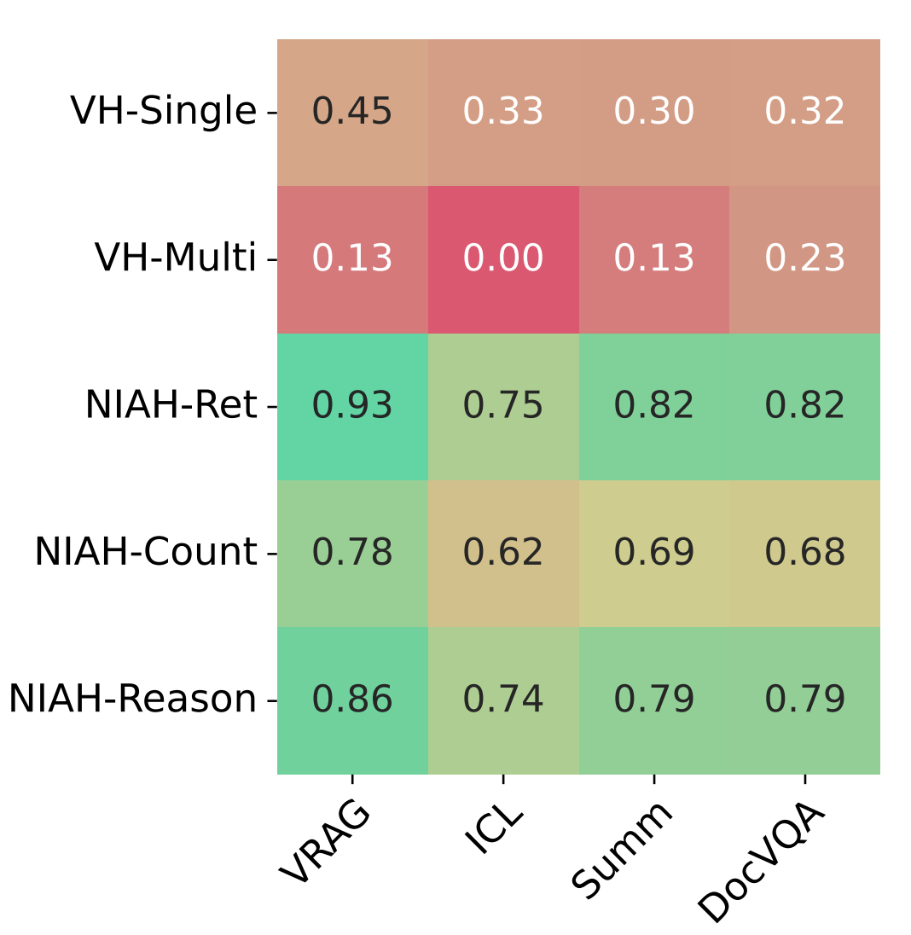
Evaluation Suggestions
Can NIAH Tasks Reflect LCVLM’s Overall Long-Context Ability?
No!
Visual Haystack: Low Correlation
MM-NIAH: < 0.8

Slide 22
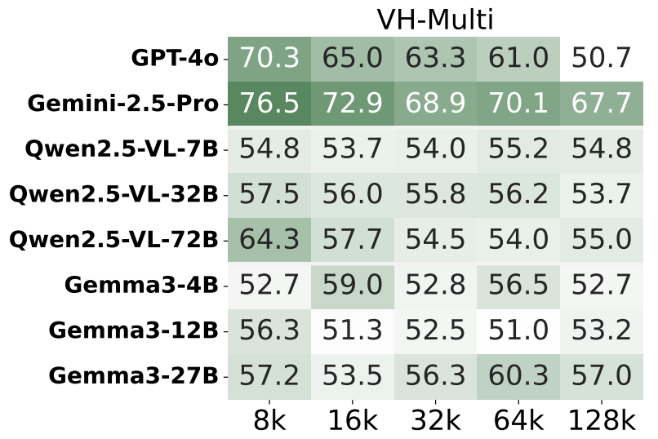
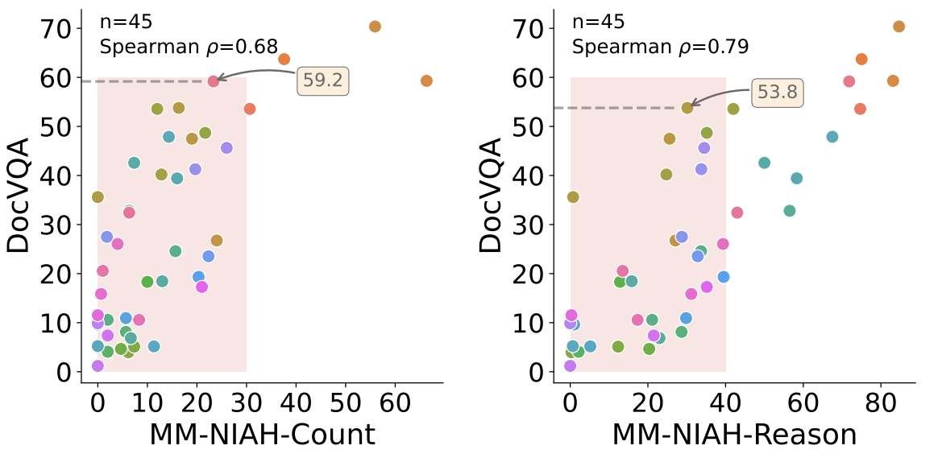
Evaluation Suggestions
NIAH tasks are hard for current LVLMs!
Random guess yields 50% accuracy,
highlighting its difficulty.
Scores below 30 and 40, poor separability between models

Slide 23
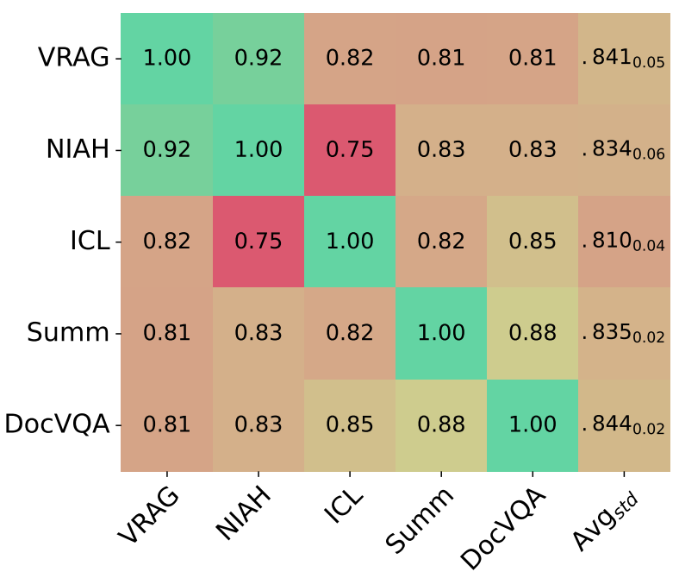
Evaluation Suggestions
Correlation Across Categories are not strong,
consistently < 0.85
We need comprehensive evaluation!
Long-document VQA is a reliable proxy
for fast iteration.

Slide 24
Error Analysis & Case Studies
MMLongBench-Doc
Use OCR-extracted text instead of PDF images (w/ OCR)
Use instruction version of Qwen2.5-7B and Qwen2.5-32B (w/ LLM; text-only models)
Categorize examples according to the answer sources: text-pure and vision-needed.

Slide 25
Error Analysis & Case Studies
Findings:
No clear winner between OCR-extracted text and PDF images
OCR text yields better performance in text-pure cases
PDF images lead to higher scores in vision-needed cases
OCR ability in long context is a bottleneck!

Slide 26
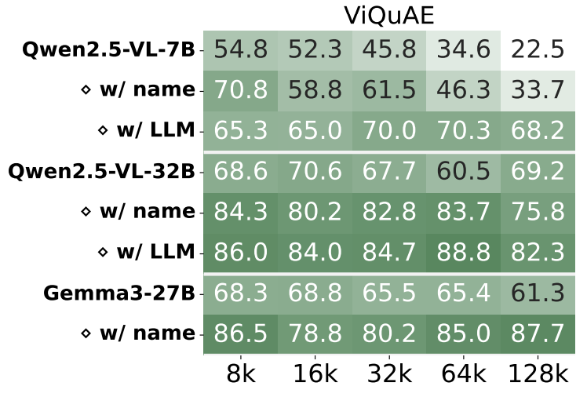
Error Analysis & Case Studies
Visual RAG (InfoSeek)
Replace the image with entity name
Use instruction version of Qwen2.5-7B and Qwen2.5-32B (w/ LLM; text-only models)
Findings:
All models improves when we use entity name
Text-only models perform better
Cross-modal retrieval in
long context is a bottleneck!

Slide 27
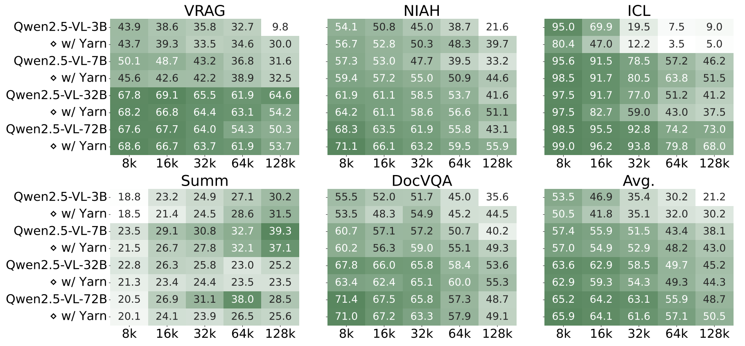
More Experiments & Analysis (YaRN)
Performance on shorter input length hurts
Only 3B model improves a lot at 128K
32B and 72B only fluctuate

Slide 28
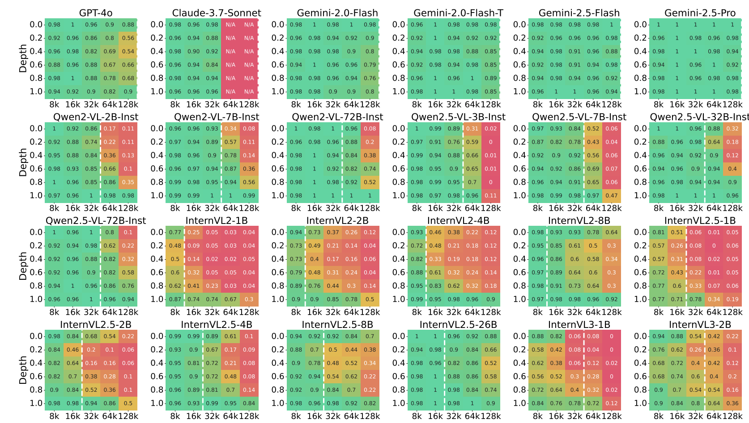
More Experiments & Analysis
Full model evaluation (46 models)
V2PE on InternVL2
Lost in the middle
…
Lost in the middle (partial)

Slide 29
Conclusions & Future Work
First comprehensive benchmark for long-context vision-language models (LCVLMs)
Rigorous, extensible foundation for diagnosing the strengths and weaknesses of frontier LCVLMs
Evaluation on 46 models reveals with rich insights
Looking forward, we hope MMLONGBENCH will serve as a standard yardstick for the community to benchmark new LCVLMs

